Slide 1
6. Building a RESTful Web Service
Roy Chancellor

Slide 2
Overview
Simple REST web service that returns a JSON object
Download project from https://github.com/roychancellor/SpringDemos.git
Instructions for running are in Application.java
Once server is running, navigate to http://localhost:8080/greeting to see a JSON object {"id":1,"content":"Hello, World!"}

Slide 3
Project Structure
Application.java: contains main() which Spring finds and runs the SpringApplication.run method
GreetingController.java: receives and responds to HTTP requests of any kind (can be limited to only GET or POST if you want)
Greeting.java: a POJO with two data fields and two getters
pom.xml: contains all of the Maven dependencies
Spring deploys the application in its own Tomcat server
Comments in the .java files explain how everything works

Slide 4
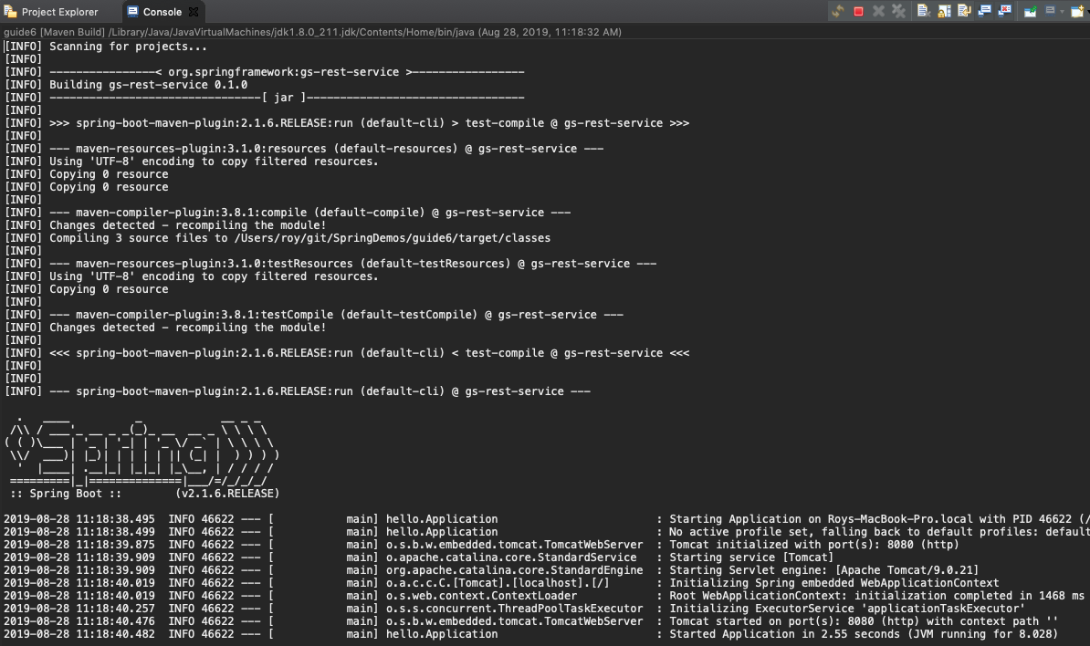
Screen Shots: Startup

Slide 5


Screen Shots: Default & Optional name Parameter

